Slide 1

Paper Talk
Zhang Yi
Nov 17, 2019

Slide 2
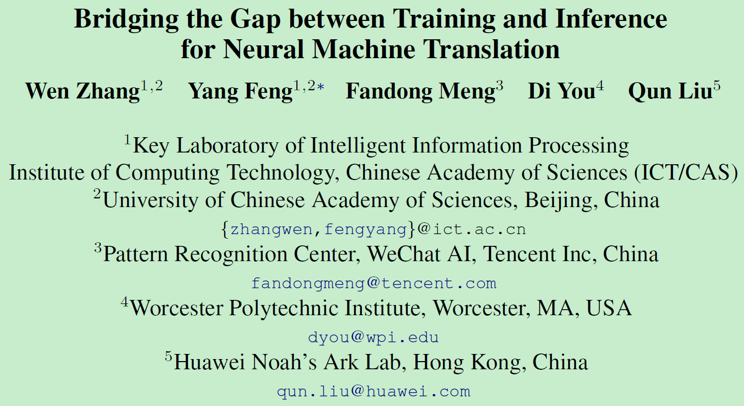
Paper Talk
Notes:
伍斯特理工学院 (Worcester Polytechnic Institute) 腾讯、诺亚方舟

Slide 3
Paper Talk
Neural Machine Translation (NMT) generates target words sequentially in the way of predicting the next word conditioned on the context words.
At training time, it predicts with the ground truth words as context while at inference it has to generate the entire sequence from scratch. This discrepancy of the fed context leads to error accumulation among the way. (data distribution - model distribution)
Word-level training requires strict matching between the generated sequence and the ground truth sequence which leads to overcorrection over different but reasonable translations.
Notes:
from scratch 从头

Slide 4
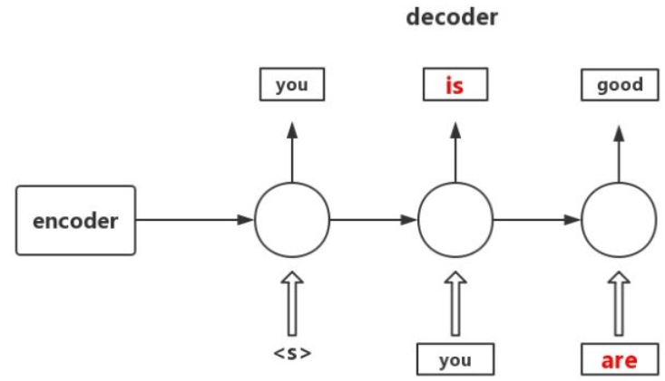
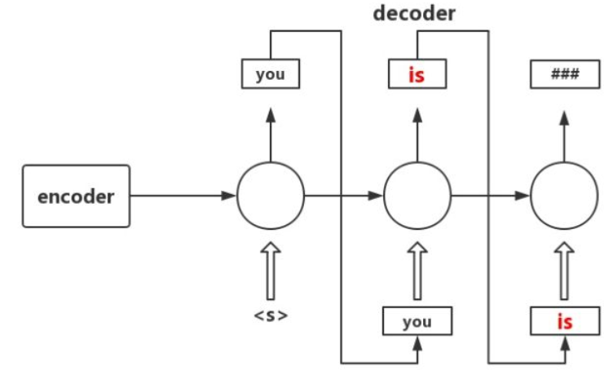
Paper Talk
Exposure bias 曝光误差
RNN在training时接受ground truth input，但 inference时却接受自己之前的output，这两个setting不一致会导致error accumulate。

Slide 5
Paper Talk
Teacher Forcing：模型生成的翻译和Ground Truth完全对应。首先，这样可能扼杀了翻译的多样性。另外，模型不可能完全保证和 Ground Truth 的译文完全一致。有时候，模型在某一句上，通过调参可以达到和 Ground Truth 完全一致的结果，但是在另一句话可能就无法达到了。对于没有达到完全一致的句子，模型会被给予惩罚，而并没有去评价翻译的结果好不好，这是一个问题。所以，对于有潜力的点，我认为训练的框架很值得研究。另外，基于语义的翻译也很值得探究。但是，目前研究成果很少，不是说不值得研究，而是难度非常大。下一步如果能对译文方面，对翻译结果有一个正确的评估，这是很重要的。
Notes:
from scratch 从头

Slide 6
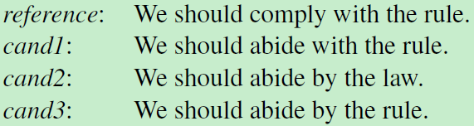
Paper Talk
Overcorrection (OR) 过度矫正
A sentence usually has multiple reasonable translations
and it cannot be said that the model makes a mistake even if it generates a word different from the ground truth word.
当模型在第三个位置预测出‘ abide’时，为了让这句话的loss最小，模型之后会预测‘with the rule’，但是‘ abide with the rule’是错误的；正确的应该是‘ abide by the rule’。

Slide 7
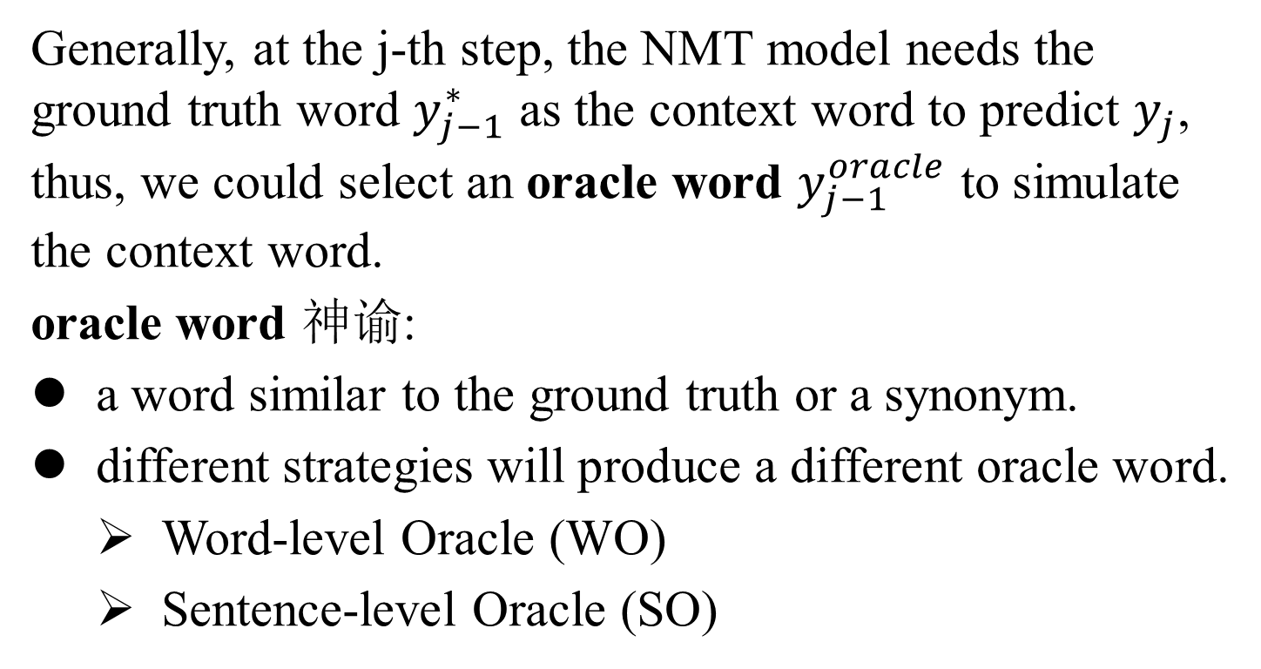
Paper Talk
Generally, at the j-th step, the NMT model needs the ground truth word $y_{j−1}^{∗}$ as the context word to predict $y_{j}$, thus, we could select an oracle word $y_{j−1}^{oracle}$ to simulate the context word.
oracle word 神谕:
a word similar to the ground truth or a synonym.
different strategies will produce a different oracle word.
Word-level Oracle (WO)
Sentence-level Oracle (SO)

Slide 8
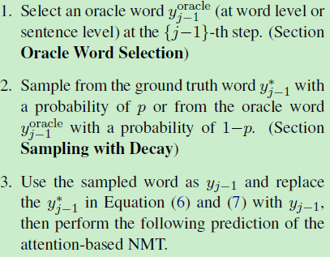
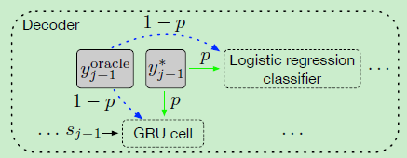
Paper Talk

Slide 9


Paper Talk
Gumbel noise
Notes:
与VAE的重参数技巧相似，是在离散概率分布的抽样技巧，并可计算梯度。

Slide 10
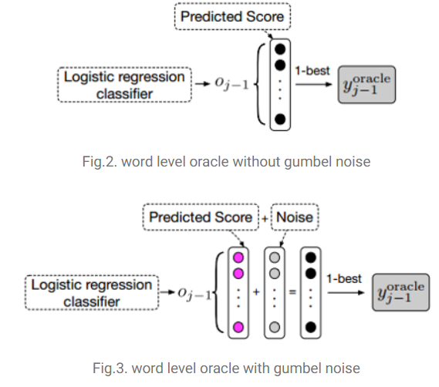
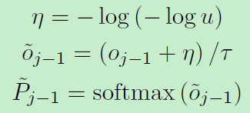

Paper Talk
Word-level Oracle (WO)

Slide 11

Paper Talk
Sentence-level Oracle (SO)
Perform beam search for all sentences in each batch, assuming beam size is k, and get k-best candidate translations.
Evaluate each translation by calculating its BLEU score with the ground truth sequence, and use the translation with the highest BLEU score as the oracle sentence.
Notes:
为了选择sentence-level oracle word，首先要进行beam-search解码，设beam size为k，得到k个candidate句子。在beam-search解码的过程中，生成每个词时也应用gumbel max技术。接着，得到k个candidate句子后，用句子级衡量指标BLEU来给这k个句子打分，得分最高的句子为oracle sentence.
当模型从真实输出YY和sentence oracle YSYS抽样，这有一个前提是，这两个序列的长度需要是一致的。但beam-search decode不能保证解码序列的长度。为了保证这两个序列长度一致，论文提出了force decoding的解决方法。

Slide 12
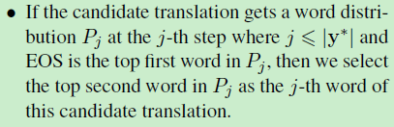
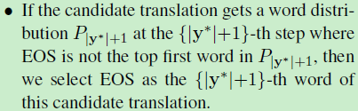
Paper Talk
Force Decoding

Slide 13

Paper Talk
Sampling with Decay

Slide 14

Paper Talk
Training

Slide 15
Paper Talk
Experiments
http://www.statmt.org/wmt14/translation-task.html

